Slide 1
Employee Data Analysis using Excel
STUDENT NAME: S.MONIKA
REGISTER NO: 312210022
DEPARTMENT: B.COM GENERAL
COLLEGE: VALLIAMMAL COLLEGE FOR WOMEN

Slide 2
PROJECT TITLE
Employee Performance Analysis using Excel

Slide 3


AGENDA
Problem Statement
Project Overview
End Users
Our Solution and Proposition
Dataset Description
Modelling Approach
Results and Discussion
Conclusion
3/21/2024 Annual Review

Slide 4

PROBLEM STATEMENT
Objective: To analyze and understand the relationship between employee performance and their salary within the organization, in order to identify key factors that influence salary decisions and to optimize performance management practices.

Slide 5

PROJECT OVERVIEW
1. Project Title:Analyzing the Relationship Between Employee Performance and Salary
2. Project Objective:The primary objective of this project is to explore and quantify the relationship between employee performance and salary within the organization.

Slide 6

WHO ARE THE END USERS?
1.Human resources(HR departments)
2.Management and supervisiors
3. Executives and senior leadership
4. Compensation and benefits analysts.

Slide 7

OUR SOLUTION AND ITS VALUE PROPOSITION
Solution:**Employee Performance Analysis Through Salary** is a comprehensive solution designed to evaluate and enhance the alignment
Value Proposition:1. **Data-Driven Decision Making:** - Our solution empowers organizations to make informed decisions about salary adjustments, promotions, and bonuses based on objective performance metrics. This ensures that compensation decisions are fair, transparent, and aligned with actual employee contributions.2. **Enhanced Employee Motivation and Retention:** - By ensuring that salaries and performance-based incentives are closely linked, employees are more likely to feel recognized and rewarded for their efforts, leading to higher job satisfaction, increased motivation, and reduced turnover.3. **Fair and Equitable Compensation Structure:** -

Slide 8
Dataset Description
Business units covered
1.Business development
2.Accounting
3.Human resource
4.Engineering
5.Marketing
EMPLOYEE ID:PR00147 TO VTo2539.

Slide 9
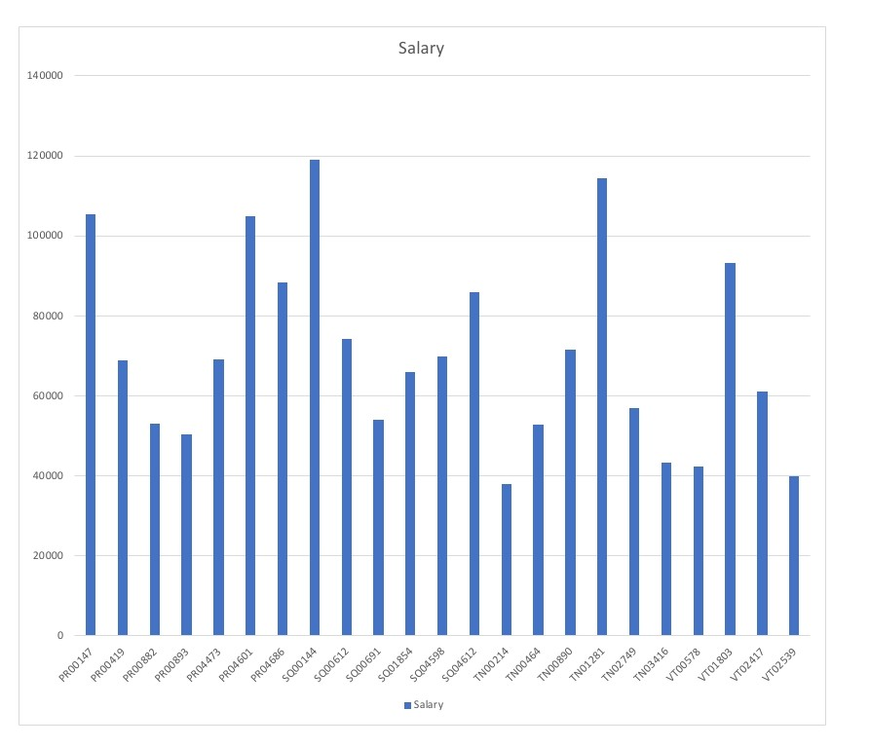

THE "WOW" IN OUR SOLUTION
3/21/2024 Annual Review
9

Slide 10
MODELLING
Data Set: employer dataset
selection: work locationData
Cleaning: missing value, imelevantFormula-performance calculation, low, medium, high
Pivot table and chart: summary, business unit, gender, employee type, employee ID, performance.
Chart: Pie, Bar, Line, Pivot chart.
10

Slide 11
RESULTS
11

Slide 12
conclusion
A conclusion for employee performance analysis through salary could be as follows :
In conclusion, analyzing employee performance through salary can provide valuable insights into the correlation between compensation and productivity. Higher salaries often reflect greater experience, skills, and contributions to the organization, but they are not the sole determinant of performance. It's essential to consider other factors such as job role, work environment, and opportunities for professional development. An effective performance analysis should, therefore, combine salary data with qualitative assessments to ensure a comprehensive understanding of employee contributions and to guide fair and motivating compensation strategies.

